Slide 1
Secure Data Hiding in Image Using Steganography
CAPSTONE PROJECT
Presented By:
Student Name :Preetam Kumar Giri
College Name & Department : KIIT
[Computer Science and Engineering]

Slide 2
OUTLINE
Problem Statement
Technology used
Wow factor
End users
Result
Conclusion
Git-hub Link
Future scope

Slide 3
Problem Statement
This project focuses on secure data hiding using steganography and AES encryption. Sensitive data is encrypted and embedded in images using the Least Significant Bit (LSB) technique. The goal is to ensure confidentiality, imperceptibility, and data integrity. Even if intercepted, the hidden data remains secure without the correct decryption key.

Slide 4
Technology used
Programming Language:
Python – Used for implementing steganography and encryption.
Cryptography:
AES (Advanced Encryption Standard) – Ensures secure message encryption.
cryptography library – Provides AES encryption and padding.
Image Processing:
Steganography (Least Significant Bit - LSB) – Hides encrypted data in images.
OpenCV (cv2) – Reads, modifies, and saves images.
NumPy – Efficient pixel manipulation.
Hashing:
SHA-256 (hashlib) – Derives a secure encryption key from a password.
Platforms & Environments:
Windows– Runs on OS with Python support.
Jupyter Notebook– Recommended development environments
File Handling & System Integration:
OS Module – Used for file handling, generating random IV (Initialization Vector) and opening encrypted images.

Slide 5
Wow factors
AES Encryption + Steganography = Double Security
Unlike basic steganography, this project encrypts the message using AES before embedding it in an image.
Even if someone extracts hidden data, they cannot decrypt it without the correct password.
Least Significant Bit (LSB) Steganography for Invisible Data Hiding
The LSB technique ensures imperceptibility, meaning the image looks unchanged to the human eye.
It avoids noticeable distortions, making detection extremely difficult.
High Efficiency & Minimal Image Distortion
Embeds data without significantly increasing file size or affecting image quality.
Uses optimal pixel selection for better security and reduced modification.
Strong Key Derivation for Enhanced Security
Uses SHA-256 hashing to derive a strong AES key from the password.
Prevents weak key attacks, ensuring robust encryption.
User-Friendly Input & Output
Simple command-line interface for encoding and decoding.
Clear error messages and warnings if an image is too small or the wrong password is entered.
Resistance to Steganalysis (Detection Attempts)
Since AES encryption randomizes data patterns, it avoids common statistical detection methods.
Unlike traditional LSB steganography, the encrypted payload appears as random noise, making detection much harder.
What Makes This Project Stand Out?
Dual-layer security (AES + LSB Steganography)
Minimal image quality loss
Cross-platform & automated image opening
Hard to detect using standard steganalysis tools
Supports large encrypted messages with optimized pixel storage

Slide 6
End users
Cybersecurity & Intelligence Agencies
Used for covert communication in intelligence operations.
Helps securely transmit sensitive messages without attracting attention.
Journalists & Whistleblowers
Can hide confidential information within images to avoid censorship.
Ensures secure sharing of critical news reports or evidence.
Government & Military Organizations
Useful for secure transmission of classified information.
Enhances communication security in sensitive operations.
Corporate & Business Professionals
Protects trade secrets and confidential data from corporate espionage.
Ensures secure internal communications within an organization.
Privacy-Conscious Individuals
Can be used by individuals to safeguard personal data from cyber threats.
Helps in securely hiding passwords, private messages, or sensitive documents in images.
Digital Forensics & Law Enforcement
Helps track hidden messages in images sent by criminals.
Can be used in investigations to retrieve embedded evidence.
Ethical Hackers & Security Researchers
Useful for testing steganographic security methods.
Can be enhanced to evaluate and improve modern data-hiding techniques.

Slide 7
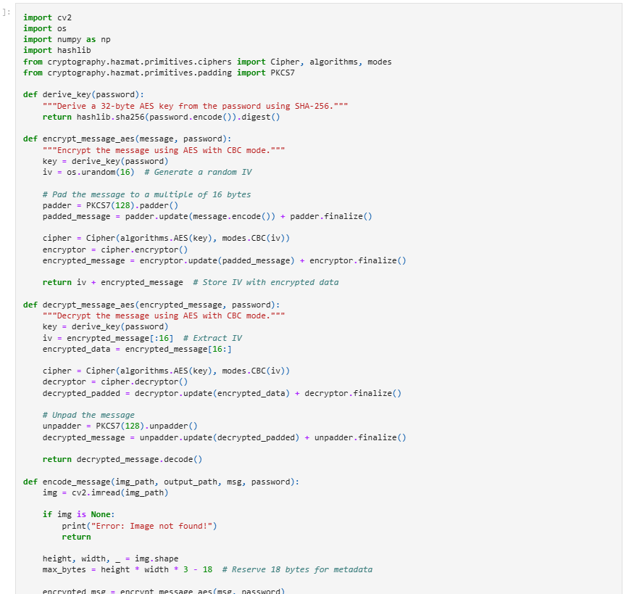

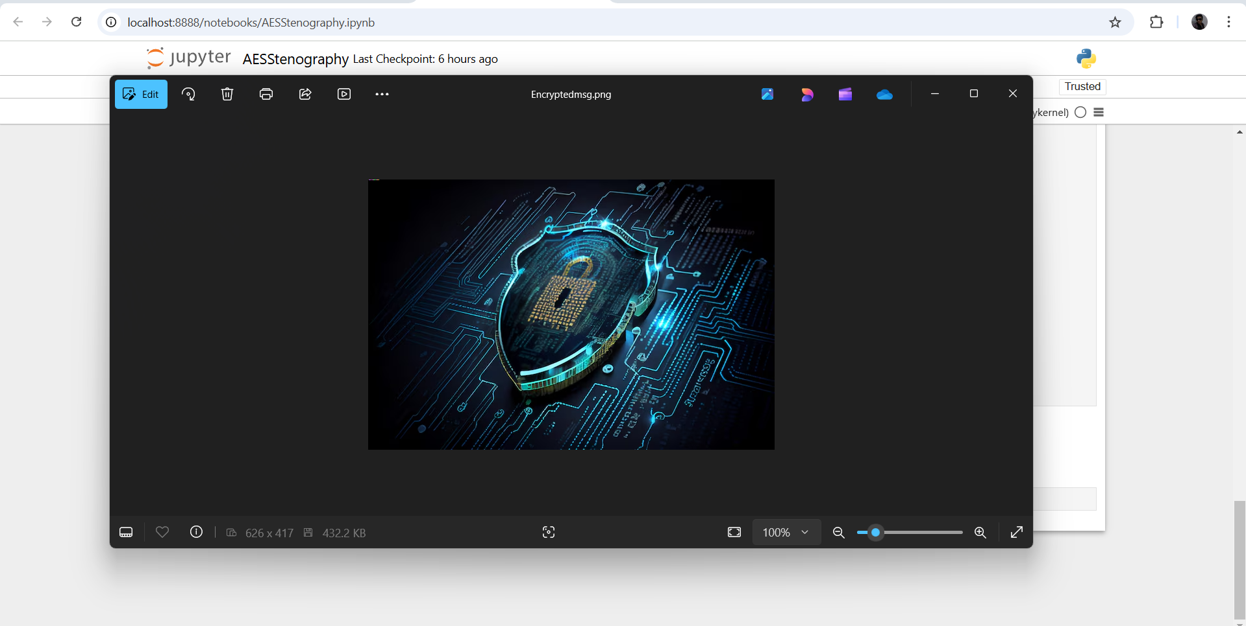

Results
Figure 3: Input image Mypic.png
Figure 1: Source code.
Figure 3: Output of the project.
Figure 4: Output image Encryptedmsg.png

Slide 8
Conclusion
This project addresses the problem of secure communication by implementing data hiding in images using steganography and AES encryption. Traditional encryption alone may not be enough to prevent interception, but by embedding encrypted messages into images using the Least Significant Bit (LSB) technique, this system ensures both confidentiality and imperceptibility.
The integration of AES encryption before embedding enhances security, ensuring that even if the hidden data is extracted, it remains unreadable without the correct key. This method provides a robust, efficient, and undetectable way to transmit sensitive information securely. It can be applied in cybersecurity, intelligence operations, digital forensics, and secure communication.
In the future, this project can be expanded with advanced steganography techniques, AI-driven detection resistance, and multi-image encoding to further enhance security and usability.

Slide 9
GitHub Link
https://github.com/PREETAM061/Stenography/tree/main

Slide 10
Future scope
Advanced Steganography Techniques
Implement adaptive steganography to hide data more securely by analyzing image properties.
Use edge-based or frequency-domain steganography (DCT, DWT) to make data embedding more robust against compression and attacks.
Support for Multiple File Formats
Extend support beyond PNG to JPEG, BMP, GIF, and TIFF for wider usability.
Optimize encoding for compressed formats without degrading security.
Enhanced Security with Multi-Layer Encryption
Integrate Elliptic Curve Cryptography (ECC) or RSA for key exchange.
Use hybrid encryption (AES + RSA) to improve security while maintaining efficiency.
AI & Machine Learning for Detection Resistance
Develop AI-powered steganographic methods that adapt based on detection algorithms.
Use GANs (Generative Adversarial Networks) to generate stego - images that are nearly impossible to detect.
Cross-Platform & Mobile Application
Build a GUI-based desktop application for ease of use.
Develop a mobile app (Android/iOS) for real-time secure communication using steganography.
Cloud-Based Secure Steganography
Implement a cloud-based secure messaging system using encrypted steganography.
Enable users to securely upload and retrieve stego - images from a cloud platform.
Resistance to Steganalysis Attacks
Improve robustness against LSB steganalysis, histogram analysis, and statistical detection techniques.
Implement randomized bit embedding to make detection more difficult.
By incorporating these future enhancements, your project can evolve into a highly secure, AI-driven, and user-friendly steganographic communication system with real-world applications in cybersecurity, intelligence, and private communication.

Slide 11
THANK YOU

